Slide 1
Gateview Technologies, Inc. Product Intro & Key Capabilities
About Gateview Technologies®
Founded in 2018, Headquartered in NC, Manufacturing in Jacksonville FL & Taipei Taiwan.
Advanced technology & automation allows industry leading power density, 3X reliability & fast delivery response.
Rack PDU focus: 15 Power types, intelligent, integrated software, environment monitoring, switching.
Six Sigma Lean Manufacturing, ISO 9001, TUV Certified Facility.

Slide 2
Rapid End User Acceptance
Founded in 2018
POWERLOK has proven to be the most reliable rPDU in the industry

Slide 3
POWERLOK Benefit Summary

Slide 4
Slim Profile plus Advanced Features
To 34.4 kW in compact 2.2 x 2” chassis.
100% Robotically Soldered
From line input to every outlet.
Reliable Cord Locking
Using standard cords.
9 Circuits at 415V 3PH (34.4 KW)
6 Circuits at 240V 3PH (17.2 KW)
0.5% Accuracy & Touchscreen Display Thermal, circuit and PDU Monitoring.
Slimmest Profile to 80A
2.2” wide X 2” deep
72 & 82” lengths are standard.

Slide 5
Angled Whip Entry & More Power in Same PDU Footprint
Multi-bay or More Power in Same PDU Footprint
Vertically Stacking Lengths | 24”, 36”, 41” to Make 72” (42U) or 82” (48U).
Angled Whip Entry
Allows stacking / Eliminates Obstruction

Slide 6
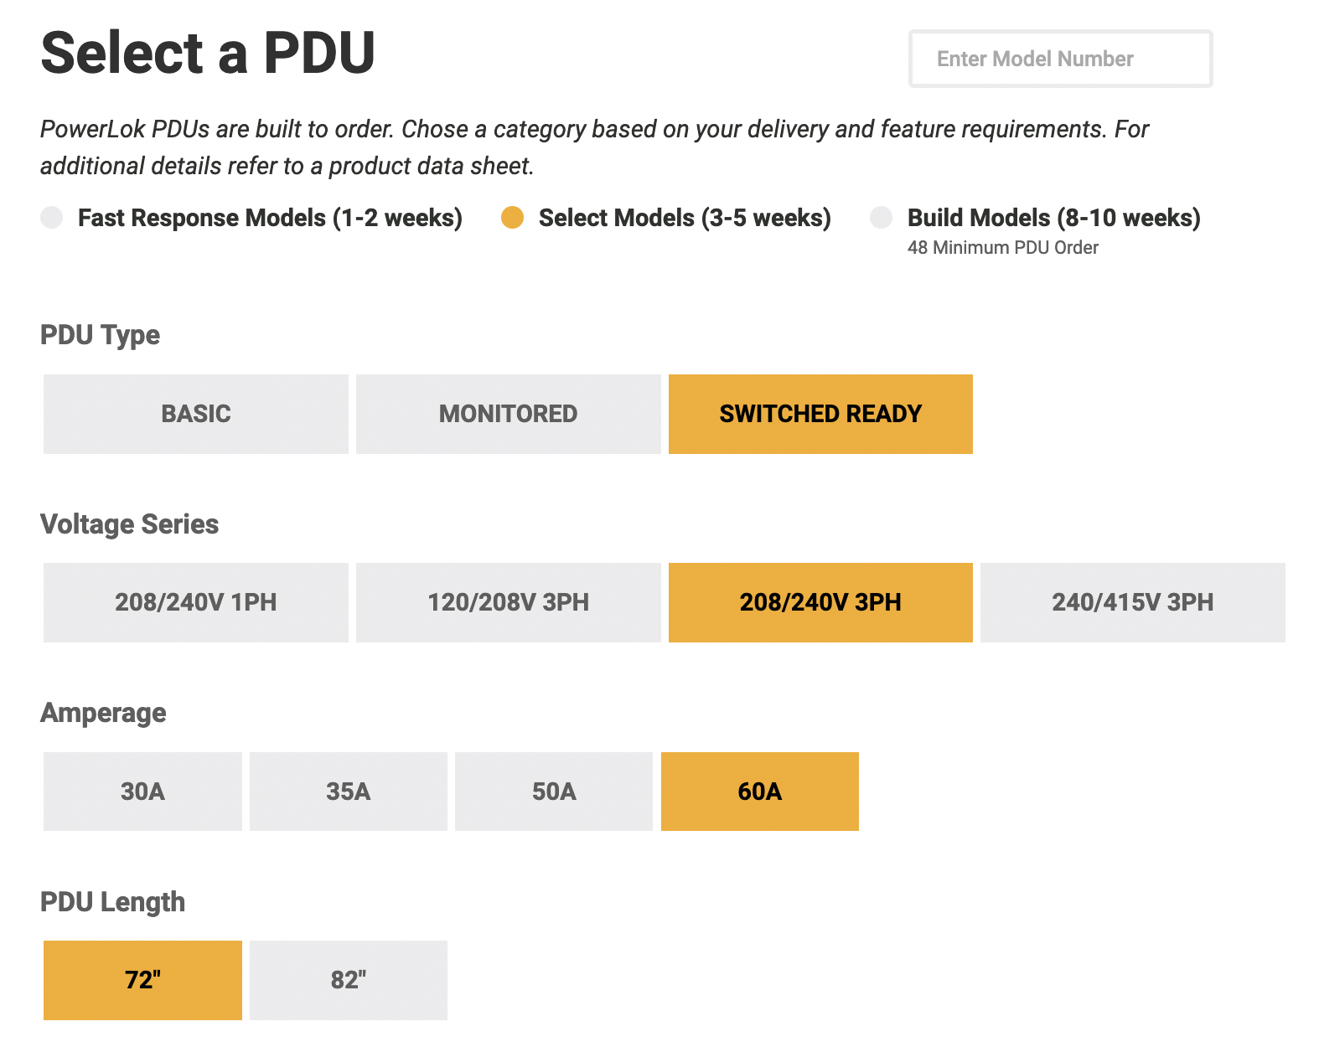
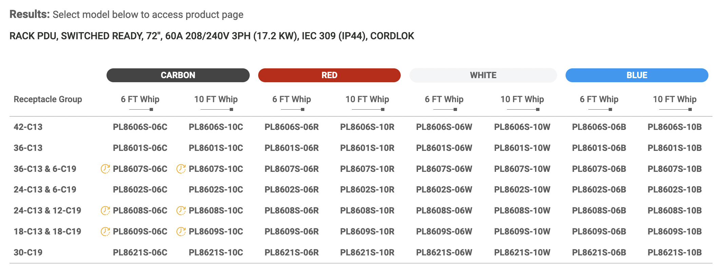
PDU Selector - Over 1400 models with < 5 week delivery
1
3
2

Slide 7
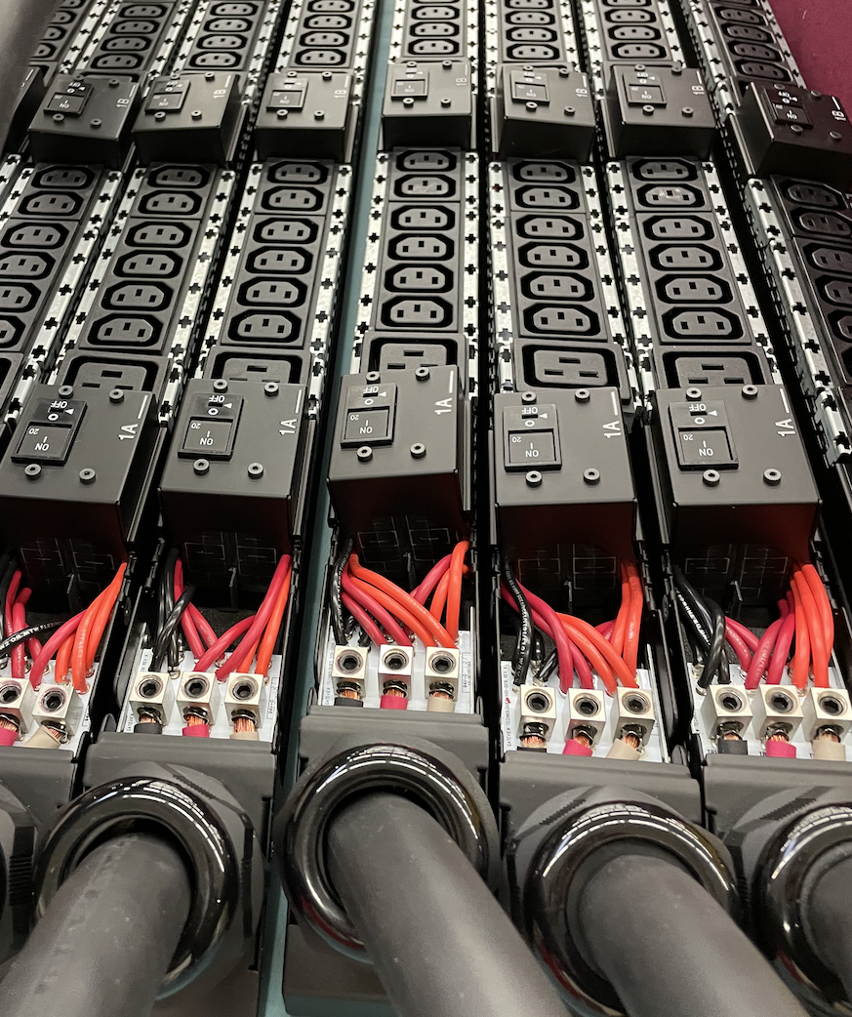
Industry’s Best Quality & Security
8200-8300SERIES | 120/208V
Better from the inside out
100% robotically soldered connections for 3X reliability and slimmest profiles.
20A 120V
30A 120V
20A 208V 1PH
30A 208V 1PH
20A 120/208V WYE 3PH
30A 120/208V WYE 3PH
60A 208V WYE 3PH
Up to 17.2 kW’s
Poor termination methods eliminated.
Reduced hand-work.
Fully automated final testing.
18 Quality proceedures for every PDU.
Built-to-order in the USA.
70+ Models in 3-5 days.
1400+ Models in 3-5 weeks.
8400-8600SERIES |
208/240V
30A 208/240V DELTA 3PH
35A 208/240V DELTA 3PH
50A 208/240V DELTA 3PH
60A 208/240V DELTA 3PH
80A 208/240V DELTA 3PH
Up to 23 kW’s
7-Year Warranty
PowerLok’s advanced deisgn and construction makes possible an industry leading 7-year Warranty.
8700-8800SERIES | 240/415V
20A 240/415V WYE 3PH
30A 240/415V WYE 3PH
60A 240/415V WYE 3PH
Up to 34 kW’s
Evaluated to be 3X less likely to experience power connection failure. Steve Fairfax, mtechnology.

Slide 8
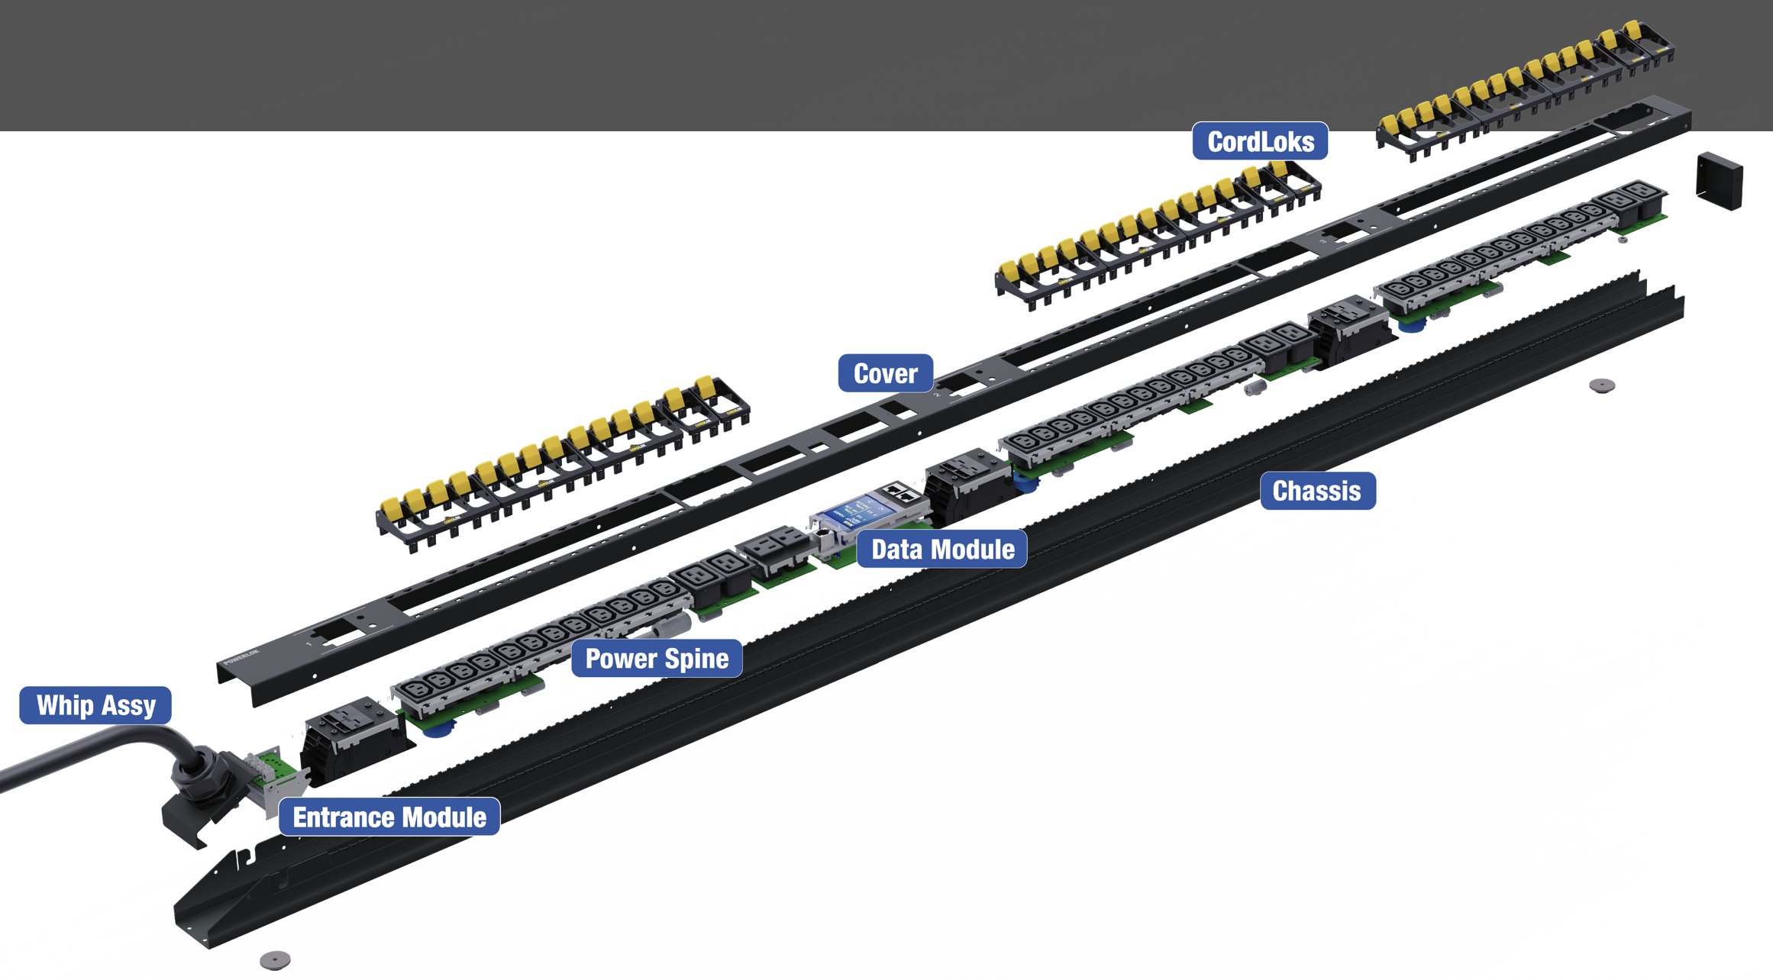
Advanced & Automated Contruction
Patent Pending
Flexible SKU mix - 1400+
Automated assembly
Interchangeable tooled carriers
Chassis carrier-rail
Standardized for 15 power types
Power Spine fully and robotically soldered before placement in chassis.

Slide 9
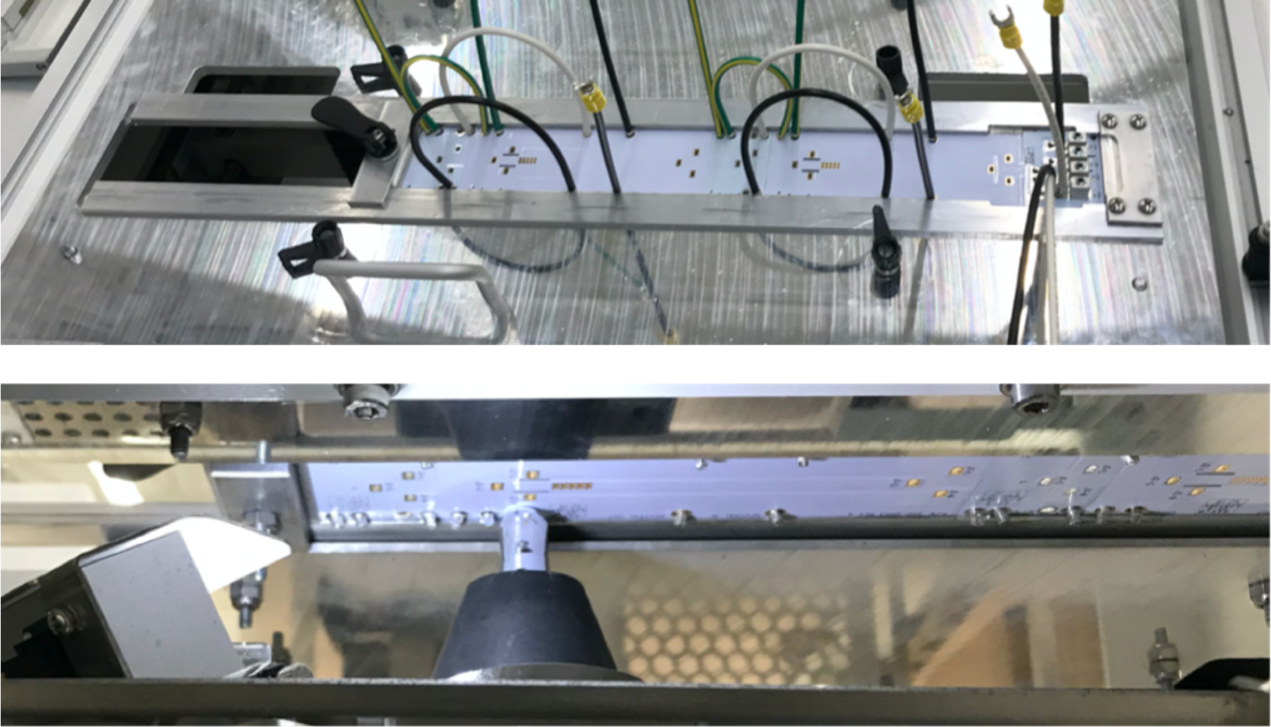
Advanced & Automated Contruction
Patent Pending
Automated soldering from line input to every receptacle eliminates all mechanical connections
Automated:
Follows NASA standards
Eliminates poor termination methods
No rat’s nest wiring as in legacy products
Greater power density
Low cost localized manufacturing
Eliminated:
Robotic head making solder terminations on receptacle boards

Slide 10
Advanced & Automated Contruction
Automated soldering from line input to every receptacle.
Eliminates all mechanical connections.

Slide 11
Fewer More Reliable Connections
Robotically Soldered - 3X More Reliable
Hand Assembled IDC & Blade Connectors - Overheat

Slide 12
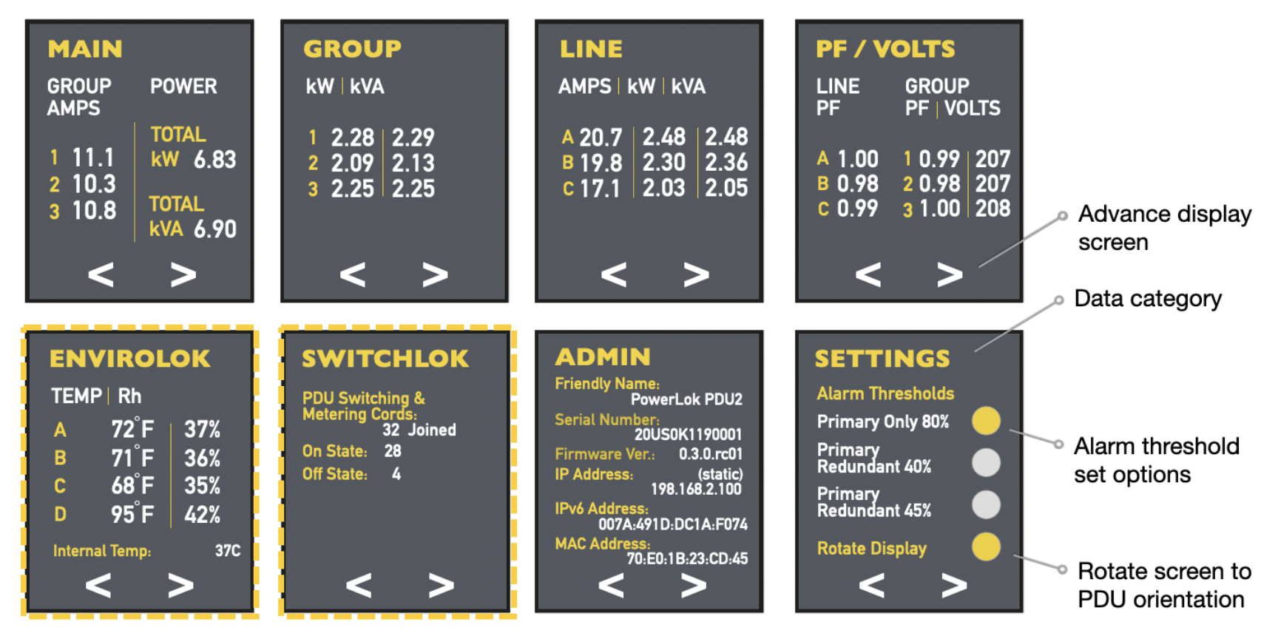
POWERLOK Software
For Power & Environmental Monitoring and Switching

Slide 13
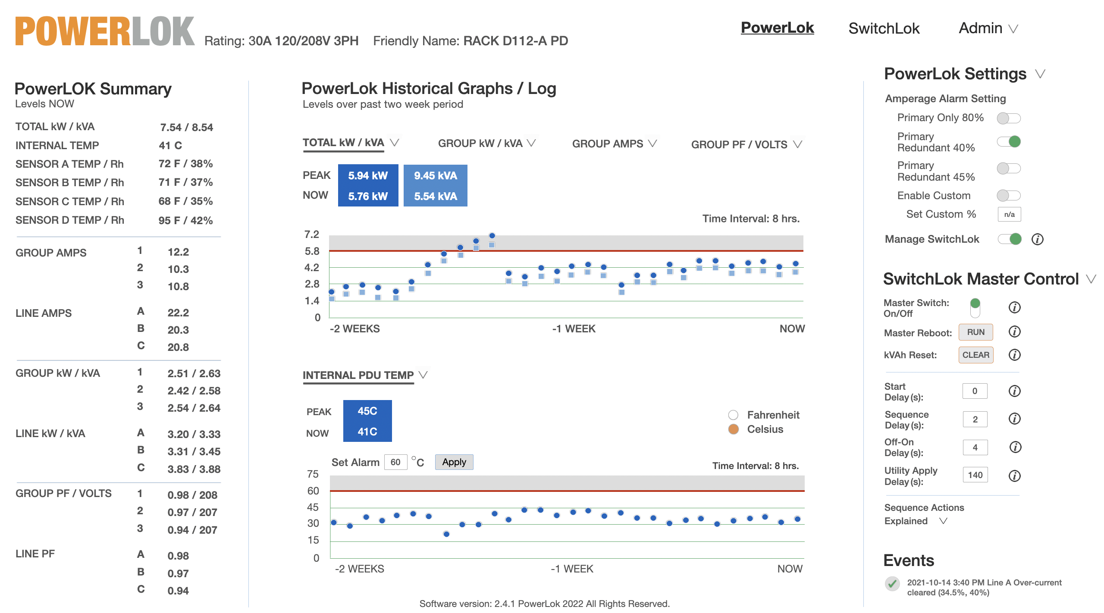
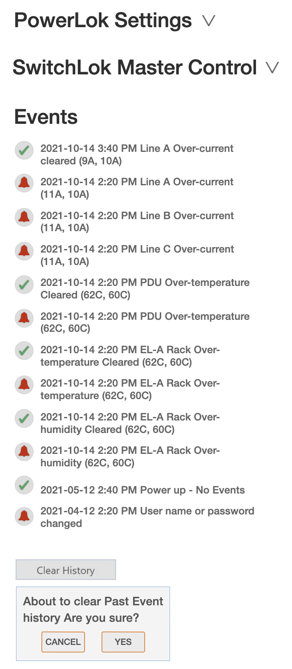
Advanced POWERLOK Software
Real time, peak and historical power data

Slide 14
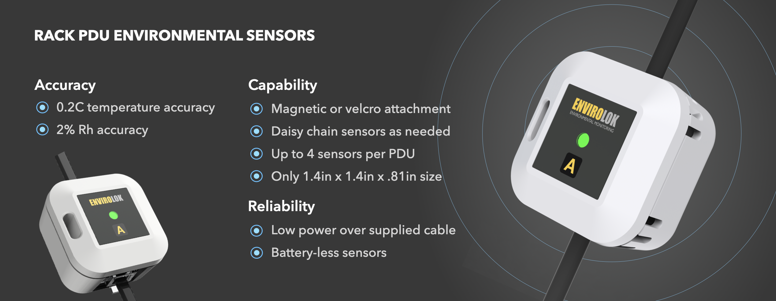
Daisy Chain Environmental Monitoring
Real time, peak and historical data

Slide 15
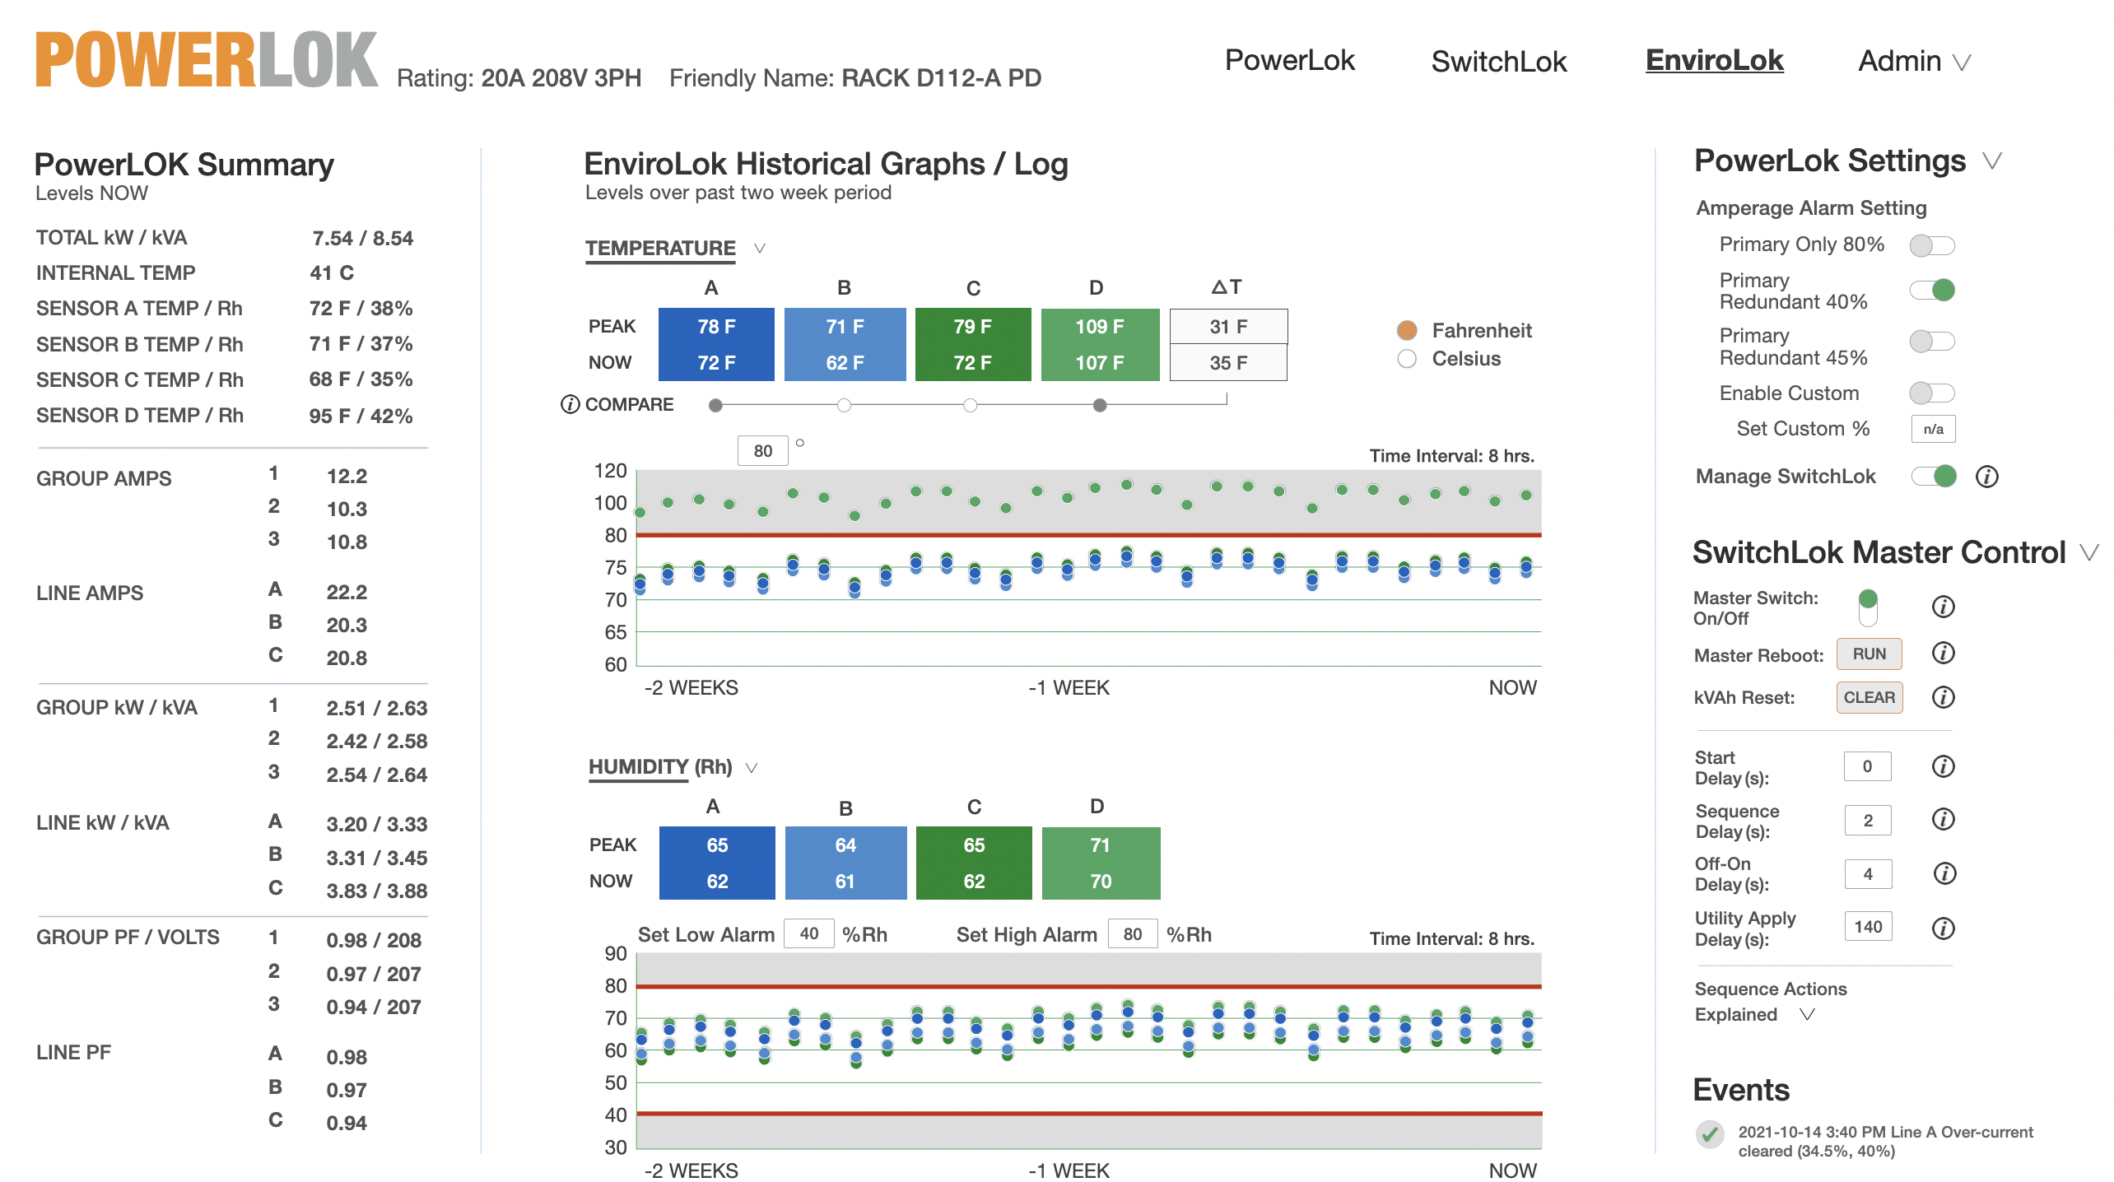
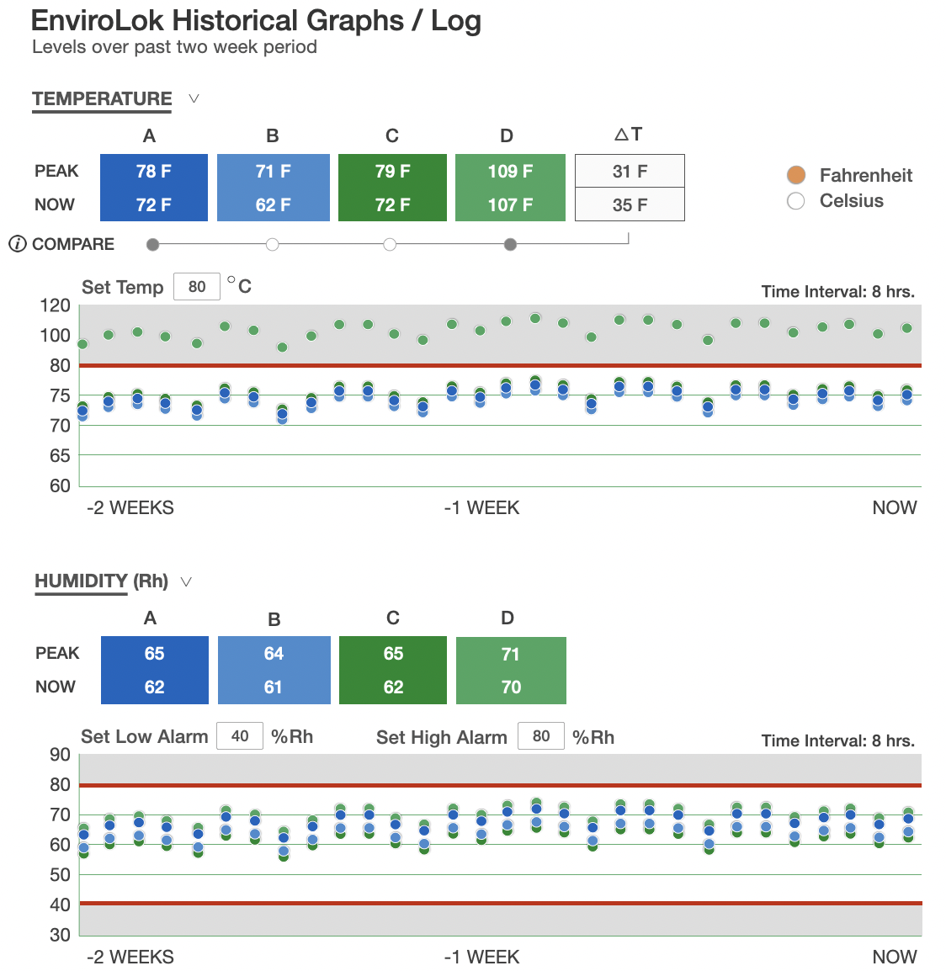
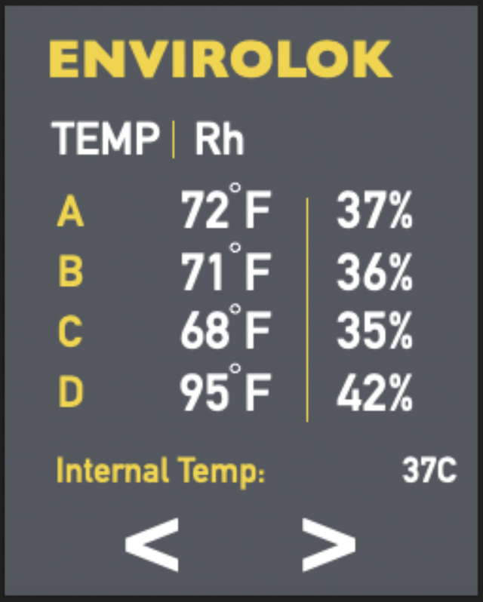
Advanced Software
Real time, peak and historical data
F

Slide 16
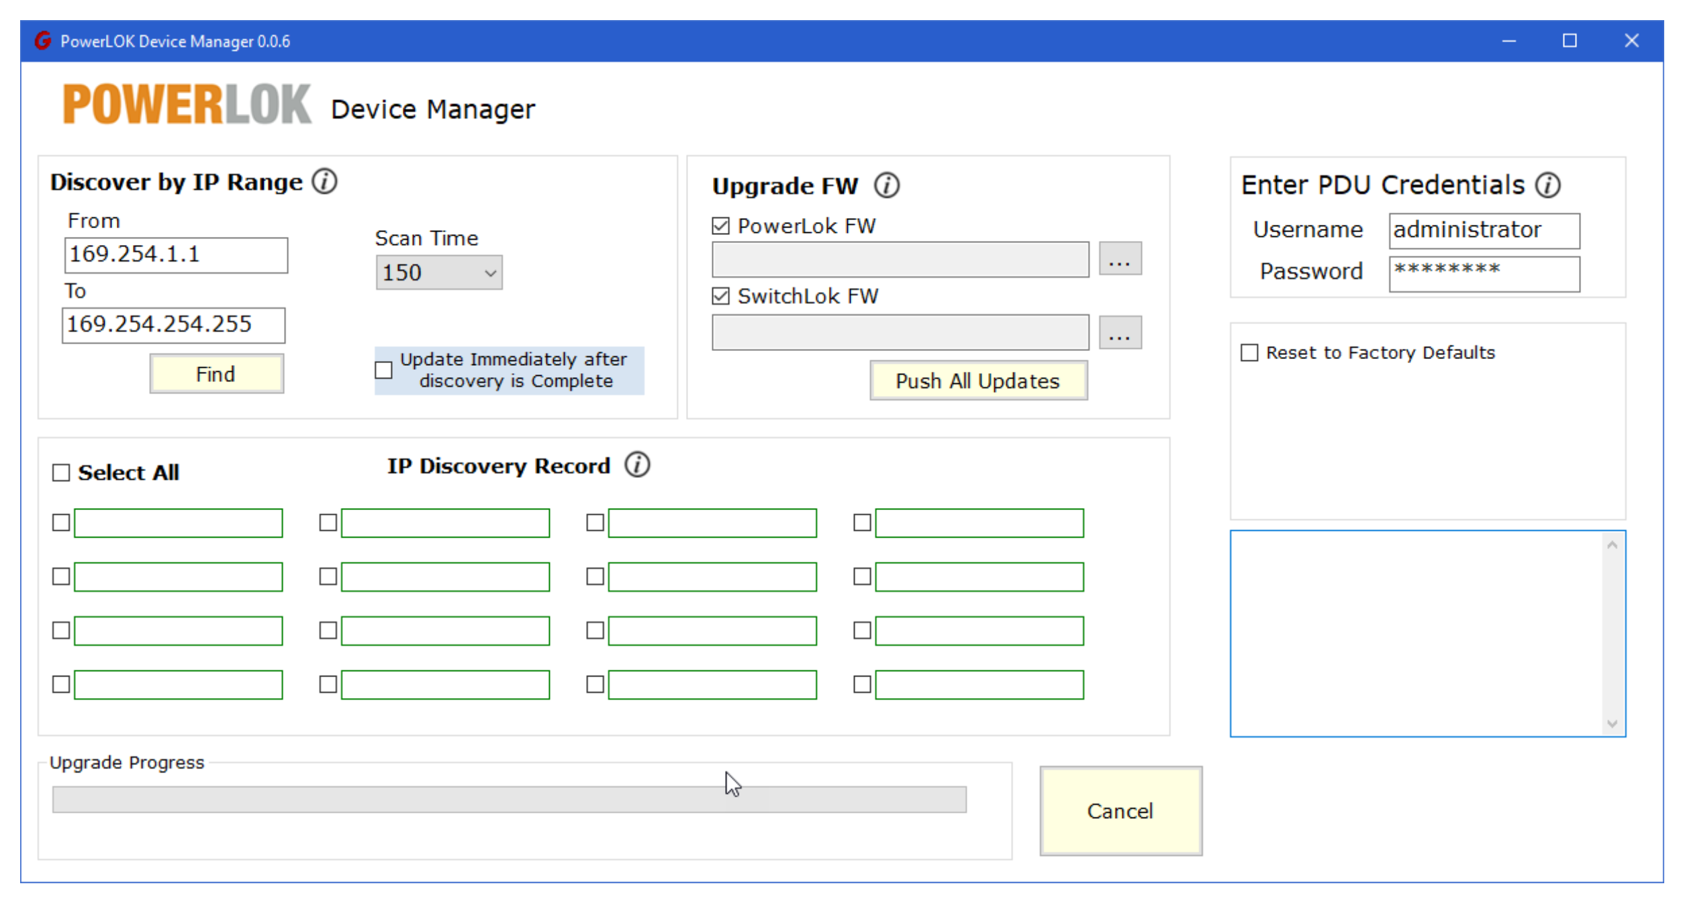
Device Manager in Beta Testing

Slide 17
PDU Switching Cords - Add When Needed
Patented
Switched Ready PDUs are remotely monitored PDUs that can be upgraded for switching at any time just by adding SwitchLOK cords.

Slide 18
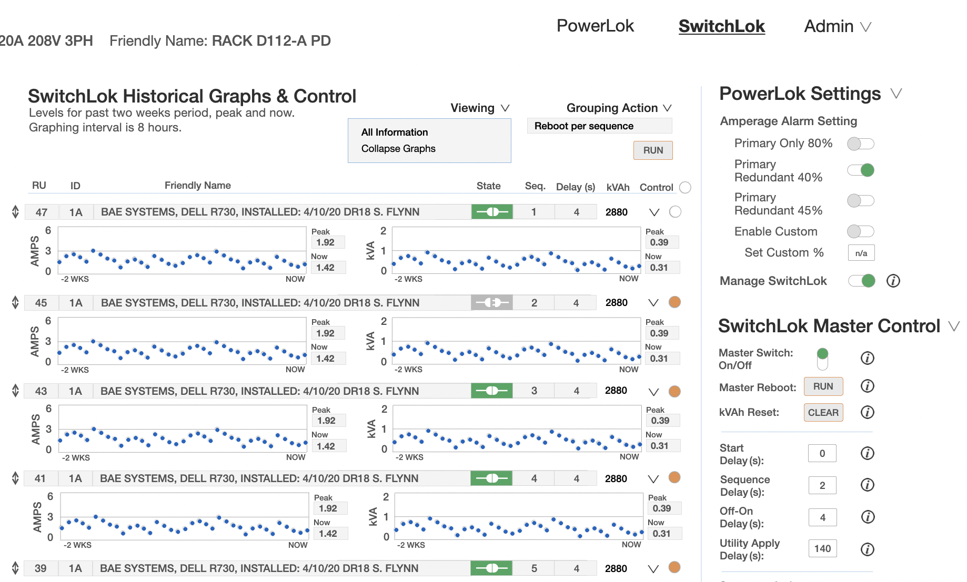
Advanced POWERLOK Software
Power & Environmental Monitoring & Switching

Slide 19
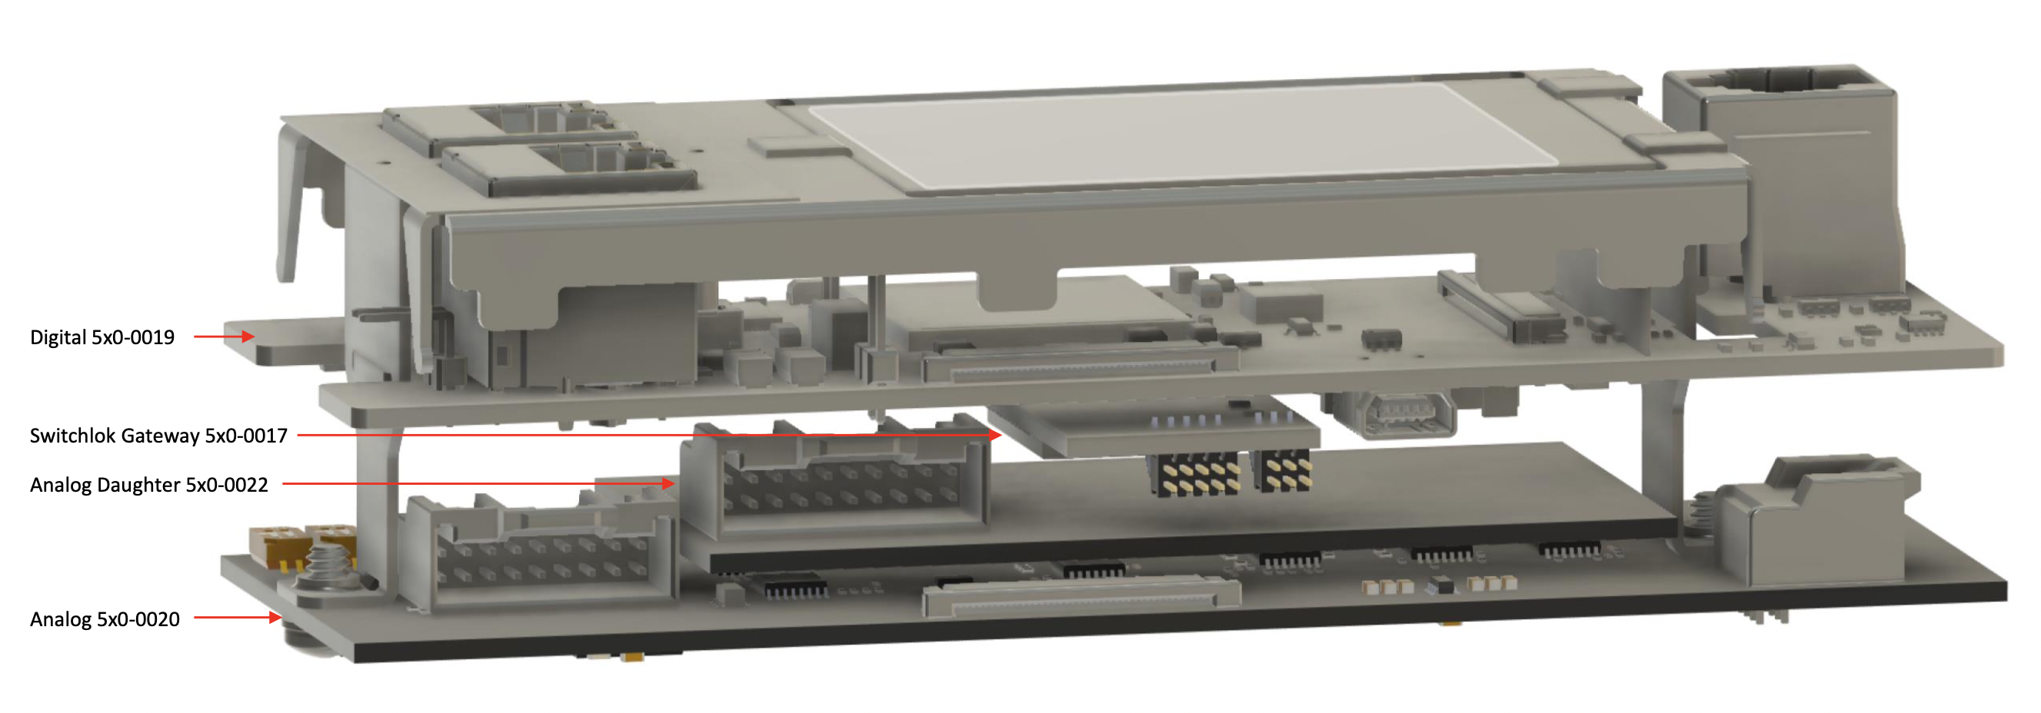
New Products
8 Slides Remaining
Advanced data module to monitor 18 groups in the same compact space
NEW DATA MODULE IN DEVELOPMENT

Slide 20
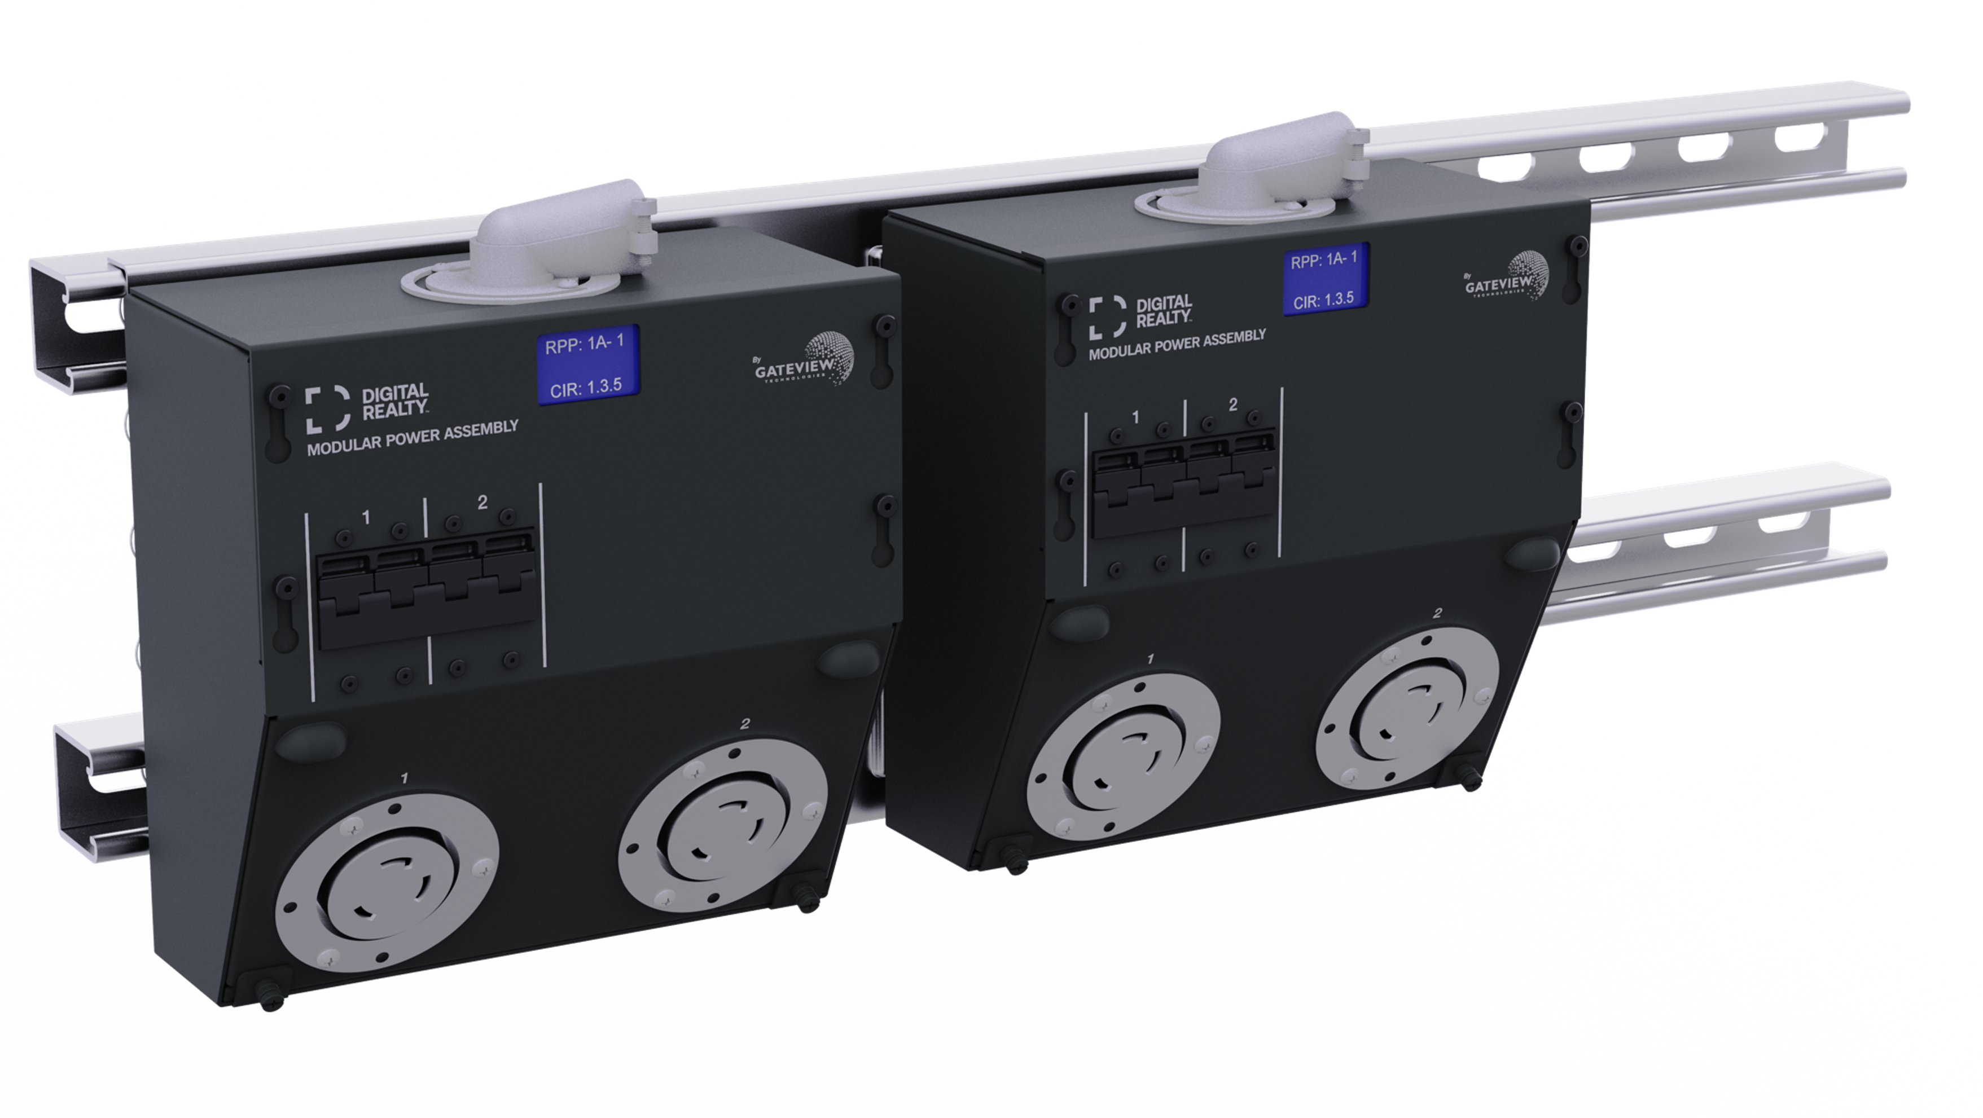
New Products
2U Rack Mount
1U Rack Mount - Basic
Modular Row Power Distribution
Gateview Technologies®

Slide 21
High Amperage rPDUs - 208V & 415V 3PH
100 & 120A PDUs with Service Entrance Option
OPTIONAL SERVICE ENTRANCE TERMINALS WITH IR SCAN WINDOW
18-BREAKERS AT 415V 3PH (69 KW)
9/15/18 CIRCUITS MONITORED
PLUS SWITCHED READY & ENVIROLOK
8400-8600SERIES |
208/240V
8700-8800SERIES | 240/415V
72 & 82” CHASSIS PROFILE 2.9” WIDE X 2.9” TALL
100A 208/240V DELTA 3PH
120A 208/240V DELTA 3PH
Up to 34 kW’s
100A 240/415V WYE 3PH
120A 240/415V WYE 3PH
Up to 69 kW’s

Slide 22
High Amperage rPDU Power Ratings Table
100 & 120A Ratings Table
AMPS | kW | BREAKER QTY | I LINE DERATED | I PHASE | I PHASE DERATED | CHASSIS WIDTH
DELTA 208/240V 3P+E WIRE (4)
100A | 28.8 | 9 | 80 | 58 | 48 | 2.90
120A | 34.6 | 12 | 96 | 69 | 64 | 2.90
WYE 240/415V 3P+N+E WIRE (5)
100A | 57.5 | 15 | 80 | 100 | 80 | 2.90
120A | 69.0 | 18 | 96 | 120 | 96 | 2.90

Slide 23
New & Planned Products
Existing Capabilities | New Products | Planned Products
15 POWER TYPES TO 80A 3PH | OVERHEAD POWER DISTRIBUTION | 100/120A PDUS
24” / 36” / 41” / 72” / 82” LENGTHS | 2U BASIC & INTELLIGENT PDUS | INTERNAL SW. OUTLET MANAGED PDUS
SLIMMEST PROFILES | ZONE PDUS | GIGABIT ETHERNET
SUPERIOR CORD LOCKING | 60A 1-PHASE PDUS | 1U INTELLIGENT PDUS
SCALABLE SWITCHING | 1U BASIC PDUS | COMBINATION OUTLET
0.5% MONITORING ACCURACY | LOWER COST 120V/208V PDUS
BUILD-TO-ORDER IN THE USA | SWAPPABLE DATA MODULE
100% ROBOTICALLY SOLDERED

Slide 24
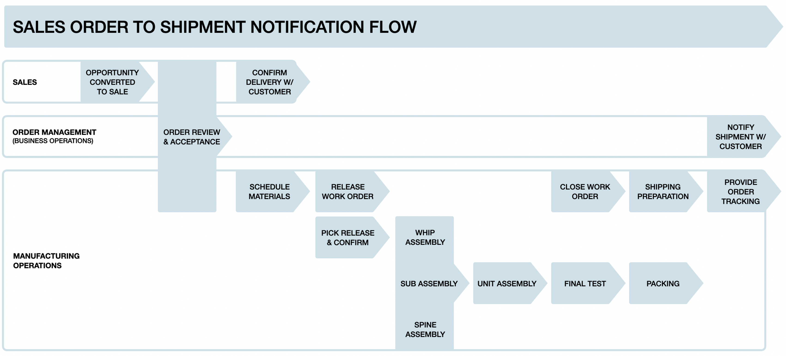
Rapid Build-to-Order & Customer Notification Process
Timeline (hours)
Timeline (weeks)
T:0
T:4
T:4-24
T:4-24
T:3-5 days 70+ Models
T:3-5 weeks 1400+ Models
Rapid document set from engineering to production in 2 hours for over 10,000 PDU models.
Progressive dies, injection molds, custom stamping tools reduce assembly to 50-70 min.
Automated final test speeds test time and ensures reliability.

Slide 25
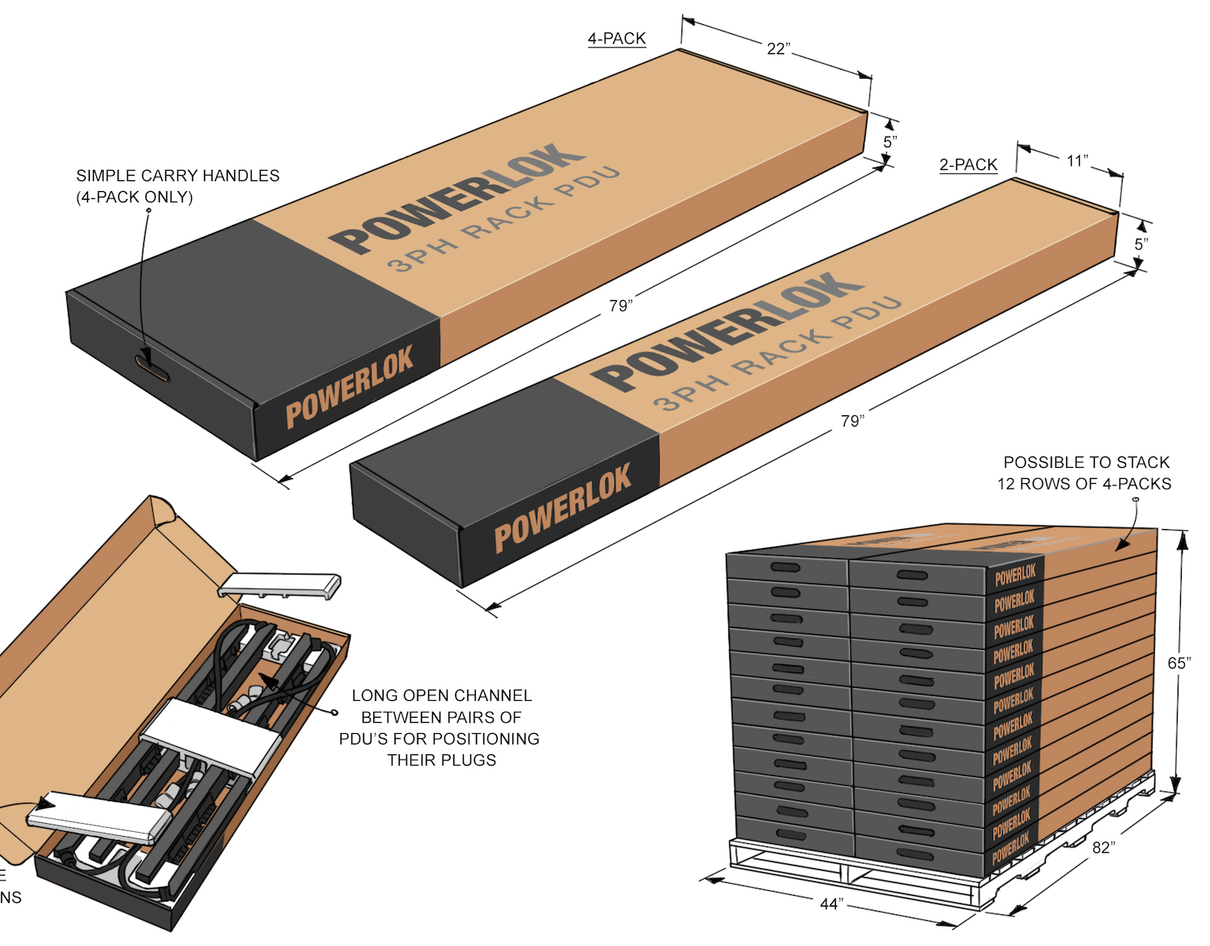
Practical Packing & Shipping
PRODUCT | QUANTITY PER CARTON | QUANTITY PER PALLET | PALLET SIZE | APPROX. PALLET WEIGHT
60A 240V 3PH | 3 | 72 | 44” X 82” X 65” | 1,600 lbs
30-50A 240V 3PH | 4 | 96 |  | 1,800 lbs
Tightly nested rPDU packaging
Up to 4 rPDUs per carton
Up to 96 rPDUs per pallet
Quickly remove rPDU from carton
All recyclable materials

Slide 26
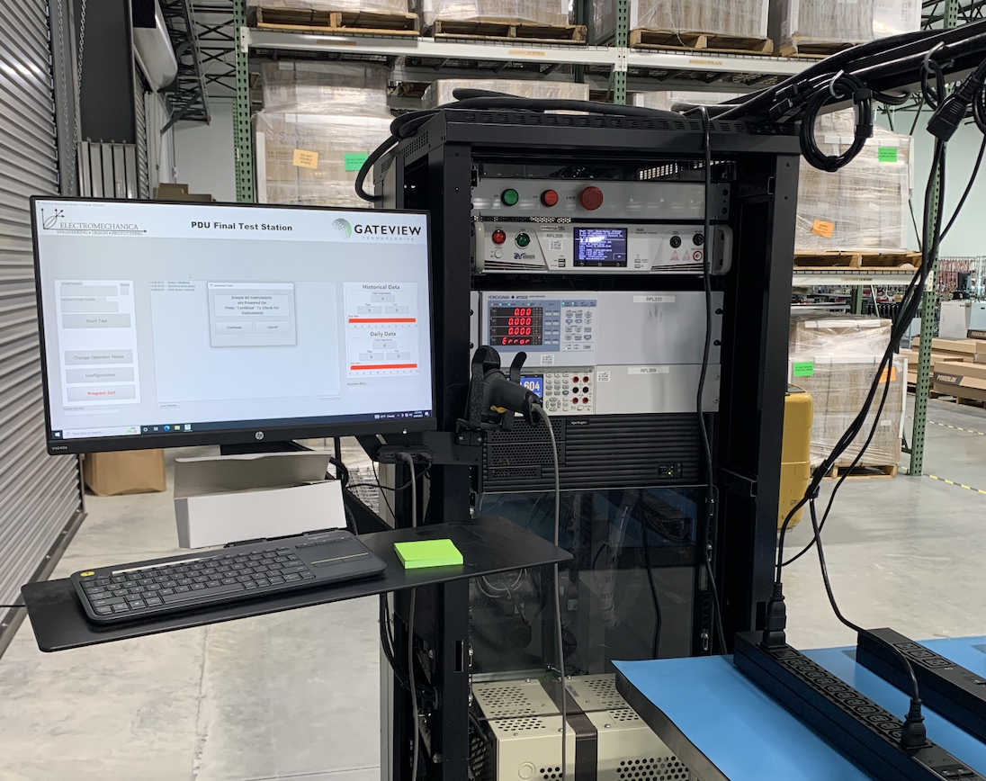
Comprehensive Quality Processes
Last slide
Production Quality Procedures & Automation
Warranty
GVT STANDARD | QUALITY STANDARD DESCRIPTION
QP000 | Quality Manual
QP001 | Receiving
QP002 | Purchasing
QP003 | Control of NC Process
QP004 | Calibration
QP005 | Auto Hi-Pot Test Procedure
QP006 | Ground Bond Test Procedure
QP007 | Internal Auditing
QP008 | Change Management Process
QP009 | Control of Documents Process
QP010 | Corrective & Preventive Action
QP011 | Design Procedure Process
QP012 | Engineering Change Order Process
QP013 | Inspection
QP014 | Manual_GateviewTestStation
QP015 | Gateview Disaster Recovery Plan
QP016 | Packaging Work Instruction
QP017 | Freight Palletizing
7-year from date of shipment, repair or replace.
If product is determined to be defective, Gateview Technologies will reimburse customer for shipping.
RMA Procedure
RMA authorization provided.
Replacement unit ships out in 1-2 days.
Unit to be returned is placed in replacement unit package and returned.
Failure analysis is provided to customer.
Automated final test fixture

Slide 27
Automated build-to-order TAA Compliant PDUs made in the USA
Slimmest profiles
Reliable locking using your cords
0.5% monitoring accuracy
Scalable switching technology
Advanced temp/humidity sensors
Colors at no additional cost
Thank You!
Advanced Technology Delivered with a Fast-Response.

